Slide 1
ADT372S ASSIGNMENT 2
By Casey Crafford
Group 3
219169640
Diploma: ICT Applications Development

Slide 2
PURPOSE
A family- owned restaurant is expanding since its rise in popularity, however before doing so changes need to be made.
With the increase in staff, orders, tables and more, the restaurant would have far too much paperwork if it were to continue using it’s paper-based system.
The family-owned restaurant wants to “go digital”: all order-taking, delivery of orders and receipt keeping needs to be computerized.
Furthermore, being in the middle of a pandemic, these changes need to ensure the restaurant remains compliant with COVID regulations.

Slide 3
SCOPE & STAKEHOLDERS
Scope
Stakeholders
Deliverables:
Develop a point of sale software for a family-owned restaurant.
Develop a database to work alongside the POS software.
Maintain compliance with COVID regulations.
Customers
Wait staff of restaurant
Management of restaurant
Investors(including banks loaned from)

Slide 4
FEASIBILITY
The system would contribute significantly to the restaurant’s overall objectives by making the ordering process far more efficient, providing up-to-date analysis on restaurant performance and decreasing the time put into paperwork to allow more time for improving the restaurant itself.
The completion date has not been finalised as of yet, however looking at the date for the component demonstration, this project can be completed on schedule. Furthermore, this project can definitely be completed within the budget. Both of these statements have been created taking into account only the use of technology currently available.
The system will integrate with the old paper-based system because it will be mostly replacing the paper-based system. Transactions and analysis of data before the system will however, not be possible because the transactions were on paper, not a previous system, and the data needed for the restaurant analysis were not tracked.

Slide 5
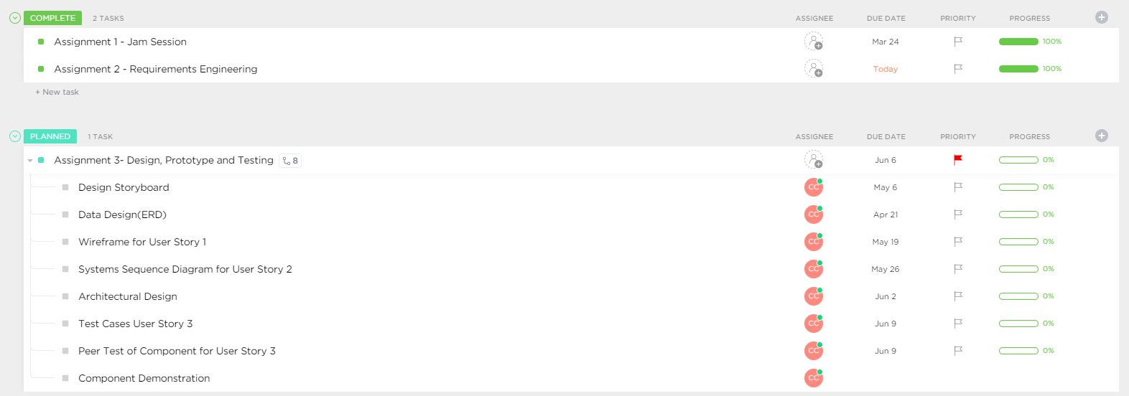
PROJECT ROADMAP

Slide 6
ETHICAL POLICY
I follow the 4 principles of ethics:
I respect the confidentiality between the employer/client and myself, regardless of a formal agreement.
I am honest about my competency and do not take on work that is out of my depth..
I respect intellectual property rights and their respective owners.
I do not partake in any form of computer misuse.
Additionally, I follow the ACM/IEEE-CS code of ethics and professional practice.

Slide 7
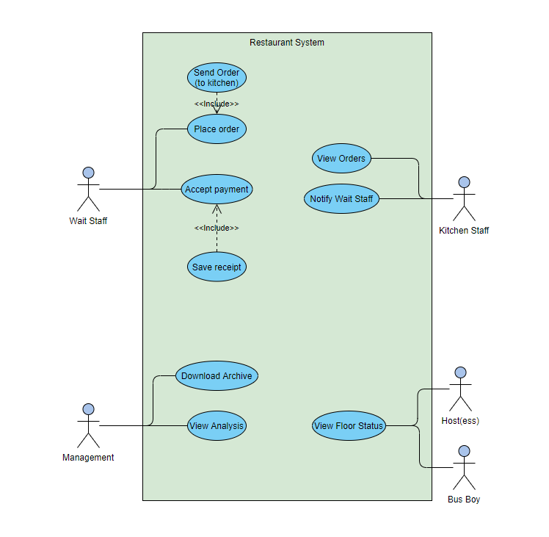
USE CASE DIAGRAM

